Slide 1
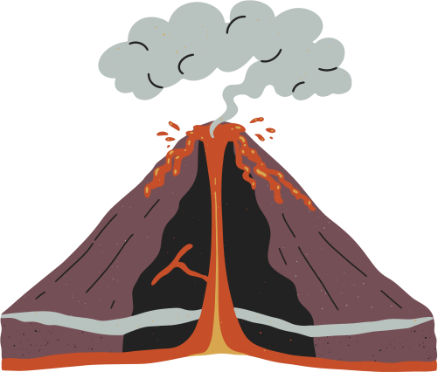


EXPLORING
VOLCANIC ERUPTIONS
PRESENTED BY: GABRIEL BEZIOU, TOM BERNHARD, ALI ABOUHACHIM-ALAMI, YOUSSEF BENADDI, MAXIME BENDAVID

Slide 2





OBJECTIVES
OBJECTIVE 1:
Analyze volcanic activity patterns and data quality over time.
OBJECTIVE 2:
Create a dashboard visualization of spatial and temporal eruption indicators as well as data accuracy indicators.

Slide 3




DESCRIPTION OF THE DATA
SHAPE:
888 rows
35 columns
KEY FINDINGS
The geological data is robust for analyzing spatiotemporal cycles
The socio-economic data is too sparse for reliable analysis => we will look into the quality of data to check for Observation bias

Slide 4



PLAN
FREQUENT PATTERN MINING
GLOBAL ACTIVITY RANKING
SPATIAL ANALYSIS
VEI DISTRIBUTION
TEMPORAL ANALYSIS

Slide 5
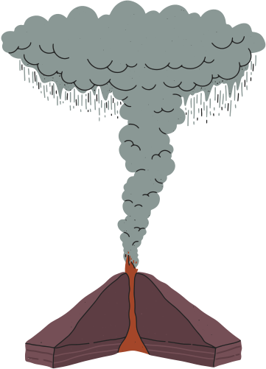



CONCLUSION
CONCLUSION 1
Apparent Increase in Activity is Due to Observation Bias
CONCLUSION 2
Volcanic Explosivity Potential is Globally and Spatially Consistent

